Slide 1
Convolutional Neural Networks
AI ToolKit
Fall Semester, 2023
Reference: mml-book.github.io && d2l.ai
Notes:
How can summarize matrices, how matrices can be decomposed.

Slide 2
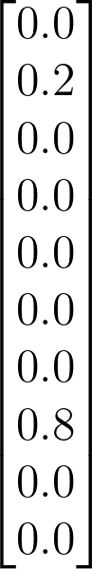

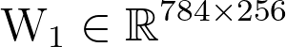

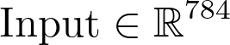
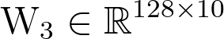
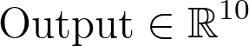
Recall : MNIST classification with MLPs
Image size : 28 x 28
Get prob. by SoftMax
Number of parameters : 28 x 28 x 256 + 256 x 128 + 128 x 10 = 234752

Slide 3
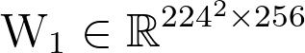
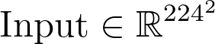
Recall : MNIST classification with MLPs
What if image becomes larger?
Image size : 224 x 224
Get prob. by SoftMax
Number of parameters : 224 x 224 x 256 + 256 x 128 + 128 x 10 = 12879104

Slide 4
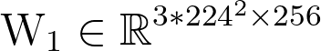
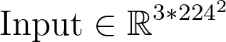
Recall : MNIST classification with MLPs
What if we have RGB image?
Image size : 224 x 224 x 3
Get prob. by SoftMax
Number of parameters : 3 x 224 x 224 x 256 + 256 x 128 + 128 x 10 = 38569216

Slide 5
Recall : MNIST classification with MLPs
Will this fully-connected layer based approach be effective when processing images?

Slide 6
Recall : MNIST classification with MLPs
Can’t we process image in a more efficient way?

Slide 7
The characteristic of Images…?
The contents of images can be similar
even if scale is changed, or transition happens.

Slide 8



The characteristic of Images…?
Can be considered as “hierarchical”
Line make shapes, shapes make patterns, …..

Slide 9
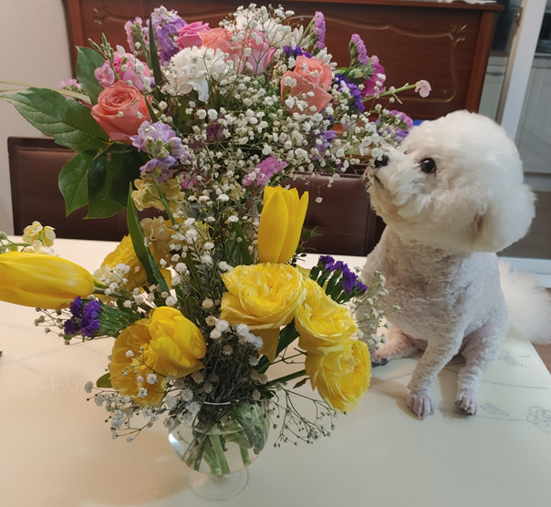
Convolutional Neural Networks: convolution layers
3D filter
i.e., 5 x 5 x 3
RGB Image
W x H x 3

Slide 10
Convolutional Neural Networks: convolution layers
convolve!
Scalar Response
1 x 1 x 1
RGB Image
W x H x 3

Slide 11
Convolutional Neural Networks: convolution layers
convolve!
RGB Image
W x H x 3

Slide 12
Convolutional Neural Networks: convolution layers
convolve!
RGB Image
W x H x 3

Slide 13
Convolutional Neural Networks: convolution layers
convolve!
RGB Image
W x H x 3
Let’s keep doing this,
until the filter slides through whole image

Slide 14
Convolutional Neural Networks: convolution layers
Total Response
M x N x 1
convolve!
RGB Image
W x H x 3
Parameter sharing
Filters are shared when processing different images
Do not look at the whole image from the beginning, try to look the local parts first

Slide 15
Convolutional Neural Networks: convolution layers
3D filter
i.e., 5 x 5 x 3
RGB Image
W x H x 3
What if we have multiple filters?

Slide 16
Convolutional Neural Networks: convolution layers
Total Response
M x N x K
RGB Image
W x H x 3
If we have K filters,
we would get M x N x K responses!

Slide 17
Convolutional Neural Networks: convolution layers
Total Response
M x N x K
What is the next thing to do
after getting the result?

Slide 18
Convolutional Neural Networks: convolution layers
3D filter
i.e., 5 x 5 x K
We say “kernel size is 5”
“channel dimension is K”
Total Response
M x N x K
We can do the `convolution’ again!

Slide 19
Convolutional Neural Networks: convolution layers
Total Response
M x N x K
We can do the `convolution’ again!

Slide 20
Convolutional Neural Networks: convolution layers
Total Response
M x N x K
We can do the `convolution’ again!

Slide 21
Convolutional Neural Networks: convolution layers
Total Response
M x N x K
We can do the `convolution’ again!

Slide 22
Convolutional Neural Networks : pooling layers
1 -1 4 1 0 5 9 0
3 5 8 3 4 -5 1 2
5
Total Response
M x N x K
Or we can subsample the response!

Slide 23
Convolutional Neural Networks : pooling layers
1 -1 4 1 0 5 9 0
3 5 8 3 4 -5 1 2
5 8
Total Response
M x N x K
Or we can subsample the response!

Slide 24
Convolutional Neural Networks : pooling layers
1 -1 4 1 0 5 9 0
3 5 8 3 4 -5 1 2
5 8 5
Total Response
M x N x K
Or we can subsample the response!

Slide 25
Convolutional Neural Networks : pooling layers
1 -1 4 1 0 5 9 0
3 5 8 3 4 -5 1 2
5 8 5 9
Total Response
M x N x K
Subsample Result
M/2 x N/2 x K
You can also get the “average” of values in 2 by 2 kernel

Slide 26

Convolutional Neural Networks : Stack Layers
Look at the local parts and get the response → Activation Func. → Subsample by Max/Avg Pooling → Look at the local parts from that response →
⇒ As the process goes into the deeper layers, extracted responses(features) would contain more high-level information!
Image from https://towardsdatascience.com/a-comprehensive-guide-to-convolutional-neural-networks-the-eli5-way-3bd2b1164a53

Slide 27
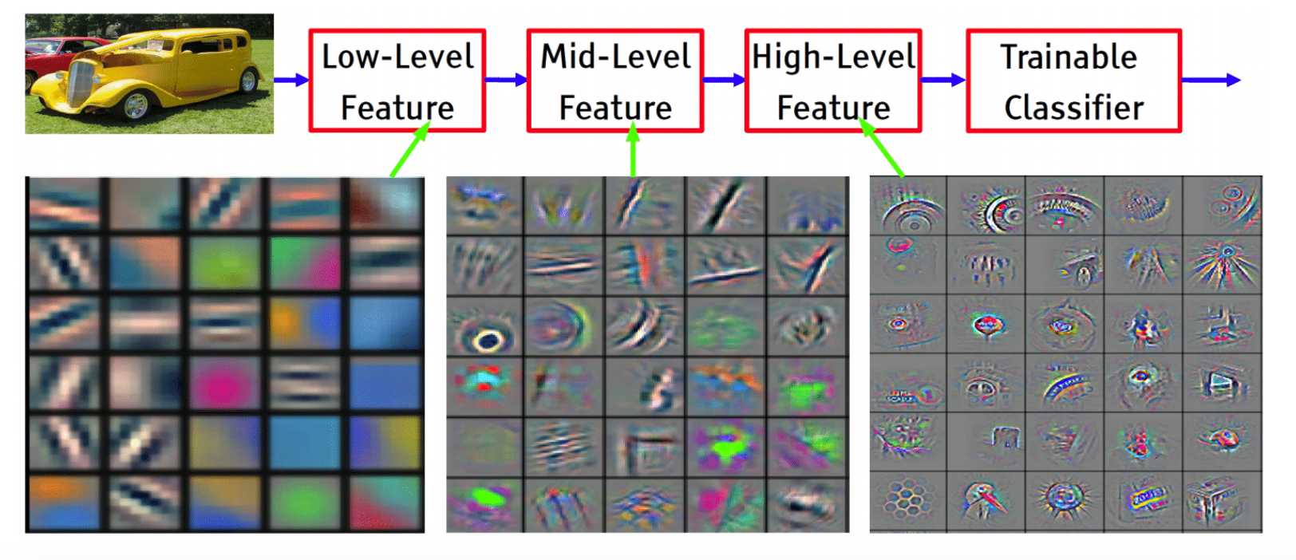
Convolutional Neural Networks : Stack Layers
Look at the local parts and get the response → Activation Func. → Subsample by Max/Avg Pooling → Look at the local parts from that response →
⇒ As the process goes into the deeper layers, extracted responses(features) would contain more high-level information!
Image from https://sailinglab.github.io/pgm-spring-2019/notes/lecture-16/

Slide 28
Convolutional Neural Networks : Be careful to Output Sizes
Kernel Size → 3
Stride (how much to move when sliding the kernel) → 1
⇒ Output Size?

Slide 29
Convolutional Neural Networks : Be careful to Output Sizes
If you want output size to be same as input, use (zero-) Padding
Kernel Size → 3
Stride (how much to move when sliding the kernel) → 1
Padding → 1
⇒ Output size?

Slide 30
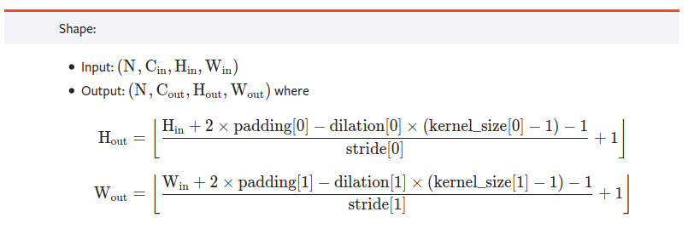
Convolutional Neural Networks : Be careful to Output Sizes
https://pytorch.org/docs/stable/generated/torch.nn.Conv2d.html

Slide 31
Convolutional Neural Networks : Be careful to Output Sizes
Poolings are easier to calculate
Kernel : 2
Stride : 2
⇒ Output size?

Slide 32
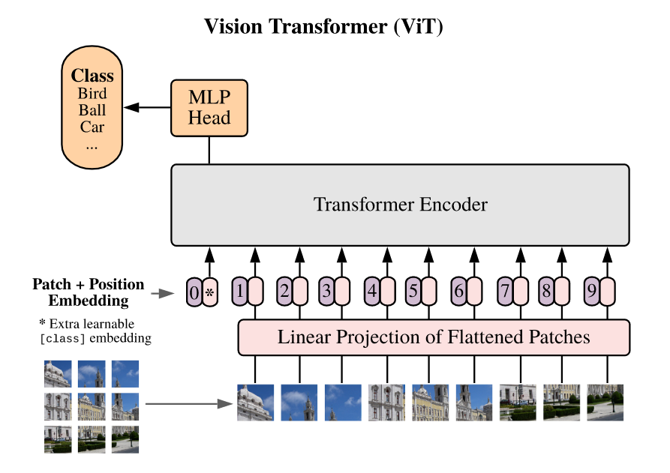
Yet another new interesting paper in these days
Dosovitskiy, Alexey, et al. "An Image is Worth 16x16 Words: Transformers for Image Recognition at Scale." arXiv preprint arXiv:2010.11929 (2020).

Slide 33
Any Questions?

